Slide 1

BUSINESS PROFILE

Slide 2

Firm OVERVIEW
Established in 1997,the company is a second tier registered public accounting and auditing firm.
The firm has been accredited as a JSE-registered auditor and reporting accountant. An accolade in which only 24 firms, including the big four auditing firms within South Africa, share to date.

Slide 3

Winning an award such as the “Audit Firm Of The Year South Africa Award”, we strive to deliver the BEST service and build all future professionals.
We represent one of the Biggest auditing firms in South Africa, of which there is only four firms.
We form a part of various organisations that makes us unique.
  HLB International ranked by the international accounting bulletin ranked the company the 12 Largest accounting network.

Slide 4
This company is dedicated to assist previously disadvantaged black people through our believes and passion.
We believe that BBBEEE is not just a compliance tick box for our company but a moral code we live buy.
We have been awarded a level 2 BBBEEE rating and we continue to drive this for a greater future.

Slide 5







MEMBERSHIPS

Slide 6
Motto
Today as a result of taking many risks and courageous entrepreneurial initiatives, the company has grown rapidly.
This growth has been achieved by total commitment to our motto “In Pursuit of Excellence”.
The company is continuously moving with the times, in an endeavour to be the first company of choice for all our clients and staff.
We strive daily to live by our motto and all our strategies are developed to ensure that our mission and vision statements are embraced by all staff members.

Slide 7

Vision
“Beyond auditing through passion and inspiration” serves as the unifying focal point of all our efforts and acts as a catalyst for our team spirit, encouraging us to move forward.

Slide 8
MISSION
The company is a dynamic and successful company of Chartered Accountants, providing personalised and value added services to clients, in order for them to succeed in a competitive market place.
As a leading and professional firm, we are constantly aware of the critical importance of customer service satisfaction. Moreover, accessibility to the expert knowledge of our experienced and uniquely skilled team enables the company to exceed our clients’ expectations.
We thrive on empowering ourselves through continuous training and mentoring, establishing a broad base of specialised services, strengthened by innovative and advanced leading-edge technology.

Slide 9

Our services
Auditing
Accounting
Taxation
Consulting

Slide 10

AUDITING
AUDIT IS ABOUT MUCH MORE THAN JUST THE NUMBERS!
It’s about attesting to accomplishments and challenges, and helping to assure strong foundations for future aspirations.
HLB illuminates the what, how and why of change so you’re always ready to act ahead.
We don’t believe in generic audits and that all companies are the same. We believe that audits should be operation and industry driven, therefore HLB assign’s relevant people with industry knowledge to specific clients.

Slide 11

Our main focus is Statutory and non-statutory Auditing.
Audits aren’t driven by quantity in our firm but by quality.
Our commitment is our Professional knowledge and responsibilities towards our services being done is driven by our passion of our services we perform.
We also provide auditing of Trust account, Financial Reports and Internal and Forensic auditing.

Slide 12
The following services only offered to our non-Audit clients

Slide 13
ACCOUNTING
Accounting can be conducted on a monthly basis or any other required period.
The company offers:
reconciliation of general ledgers,
creditors,
debtors,
fixed asset registers.
The company covers the complete process of determining the income and expenditure of the organisation for the period under consideration.
We can also provide for the subsequent control, monitoring and comparison between actual, forecasted and authorized budgets.

Slide 14

Other Accounting Services include:
Preparation of financial reports for Boards of Directors, Management and Statutory Bodies;
Preparation of cash flow statements, financial information for banks and other financial institutions;
Maintenance and evaluation of accounting records, related systems and recommendations and improvements;
Administration of client's monthly payroll, which may include:
  Calculation of monthly salaries;
  Supply of monthly pay slips;

Slide 15

TAXATION
Corporate taxation represents a substantial part of your trading cost and time.
We help clients to minimise their corporate tax exposure as well as related personal taxation.

Slide 16
We do Taxation by:
Determining tax effective structure for your business
Taking full advantage of tax opportunities (rebates and provisions)
Achieving optimal capital or revenue tax treatment
Reducing tax on disposals and maximising tax relief on acquisitions
Meeting rigorous demands of compliance including corporate taxation self-assessment
Acting on clients behalf in discussions with the tax authorities

Slide 17
Personal Taxation services
Calculating
Calculating your tax liability
Completing and filing
Completing and filing tax return on your behalf
Advising
Advising when various tax payments and their respective amounts are due and payable
Advising
Advising on the appropriate record retentions for taxation purposes

Slide 18
Taxation Planning and Administration
Tax compliance for corporates, Trusts and Individuals;
Completion and lodging of tax returns;
Preparation and lodging of VAT returns from accounting records;
Registration as an employer, registration for provisional tax, income tax, workmen's compensation, VAT, UIF, SDL and PAYE;
Implications of income tax legislation and capital gains tax legislation;

Slide 19

CONSULTING
Innovation, transformation and leadership occur in many ways.
At HLB, our ability to help solve clients’ most complex issues is distinct.
We deliver strategy and implementation, from a business and technology view, to help you lead in the markets where you compete.

Slide 20
Estate Planning & Administration of Deceased Estates
Tax efficient estate planning
Acting as executor, administrator of estates and trustees of family trusts
Investments
New Businesses & industry specific consulting
Advice on investment strategies
Conducting financial investigation into low returns on investments
Advice and assistance on the start-up of new businesses
Consulting on important topics that are specific and relevant to client

Slide 21

SERVICE PLEDGE
Industry experts will be assigned to company.
Continuation and strive from assigned team over the tenure period the contract award has been received for.
Auditing staff will understand the companies accounting standards, legislation and industry factors directly impacting the company.

Slide 22

Clients deal directly with our directors.
Fee structures are tailored packages with regards to our company in which we take time to understand your operations before we issue a quote.
HLB has a total of 250 qualified staff members that assists with their expert skills and professional ethics.

Slide 23




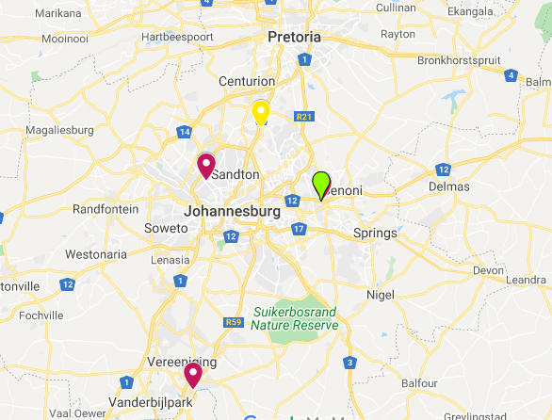
GEOGRAPHIC REPRESENTATION
Head Office - Midrand
Vereeniging Office
Windsor West
Farramere- Benoni

Slide 24
Contact us
Tel : (011) 315 0215
Cell : 082 571 7007
Email: mariusjm@mbainc.co.za
Should you require any further information, log onto our website:
http://www.hlbauditor.co.za/

